Slide 1
IO organization
Introduction to Peripheral Devices,
I/O interface,
Direct Memory Access ( DMA),
I/O Processor,
Data communication processor

Slide 2
Peripheral Devices
Provides an efficient mode of communication between the central system and the outside environment
Peripheral Device: Input or Output devices attached to the computer
Types:
Input device: keyboard, mouse, joystick etc.
Output device: Monitor, printer etc.
Input-Output device: Memory

Slide 3
Input-Output Interface
Provides a method for transferring information between internal storage and external I/O devices.
Provides special communication links for interfacing I/O device with CPU
Purpose of I/O interface is to resolve the differences that exist between CPU and each peripheral
Conversion of signal values (CPU—electronics devices, and peripherals – electromechanical and electromagnetic devices)
Synchronization (data rate is different)
Data codes and formats in peripherals differ from the word format in the CPU and memory
The operating modes of peripherals are different from each other an each must be controlled so as not to disturb the operation of other peripherals connected to CPU (Device selection)

Slide 4
I/O bus and Interface Modules
I/O bus provides communication links between the CPU and several PD.
I/O bus consists of
Data bus
Address bus
Control bus
Each Peripheral device (PD) are connected to the I/O bus through its associated Interface
Function of interface:
Decodes the address and control received from the I/O bus
Interprets them for the peripherals
Provides signals for the peripheral controller
Synchronize the data flow and supervises the transfer between peripheral and processor.

Slide 5
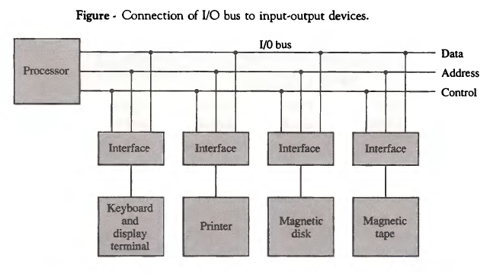
Contd..

Slide 6
Contd..
To communicate with particular device, CPU issues an address on address line and function code (AKA I/O command) on control lines of that particular device
Each interface associated with PD monitors address line
If it detects its own address then it activates the path between bus lines and PD
The Selected device responds to the function codes and proceeds to execute.

Slide 7
Contd..
There are four types of function codes:
Control command
Issued to activate the PD and to inform it what to do
Status command
Used to test various status condition in the interface and the PD
Data output command
Causes the interface to receive the data from the data lines
Interface communicate with PD and send this received data to the PD
Data input command
Causes the interface to place the data from its register to the data lines.
Interface receives the data from PD and store its in buffer

Slide 8
I/O versus Memory Bus
CPU must communicate with both I/O as well as Memory
Both I/O bus as well as Memory bus contains data, address and control lines.
Three ways that computer buses can be used to communicate with memory and I/O
Use two separate buses, one for memory and the other for I/O
Use one common bus for both memory and I/O but have separate control lines for each
Use one common bus for memory and I/O with common control lines

Slide 9
Isolated versus Memory – mapped I/O
Isolated I/O
CPU has separate instructions for I/O data transfer and memory data transfer.
It uses separate address space for I/O and memory operation
Usually I/O mapped I/O is used to map devices like 8255A (PPI), 8251A (USART) etc.
Memory mapped I/O
CPU does not have separate address space for I/O and memory
No specific input or output instructions
The CPU can manipulate I/O data residing in interface registers with the same instructions that are used to manipulate memory words.
Usually memory mapped I/O is used to map memories like RAM, ROM etc.

Slide 10
Assignments
Explain I/O interface with examples in details.

Slide 11
Modes of transfer
Data transfer to and from peripherals can be done in one of the three possible modes:
Programmed I/O
Interrupt-Initiated I/O
Direct Memory access (DMA)
Programmed I/O
Data transfer takes place under the program control
Requires constant monitoring of the peripheral by the CPU so time consuming process and less efficient one.

Slide 12
Contd..
Interrupt – Initiated I/O
CPU need not to requires constant monitoring of the PD hence more efficient than Programmed I/O
PD issue an interrupt signal when the data are available
Once CPU detects external interrupt signal then it momentarily stops the ongoing task and branches to a service program to process the I/O transfer, and then returns to the task it was originally performing.
DMA
Very efficient for bulk data transfer
Data transfer takes place in between memory and peripheral device directly through memory buses without the involvement of CPU.
CPU becomes free during DMA transfer so it can continue the task that does not require memory operation otherwise it would stay idle.

Slide 13
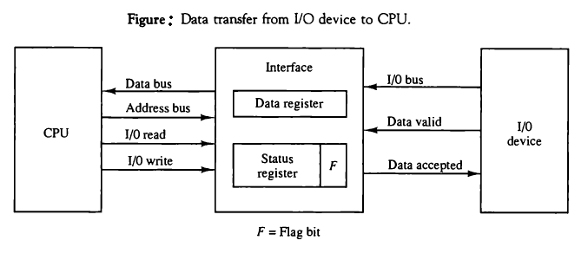
Example of Programmed I/O

Slide 14
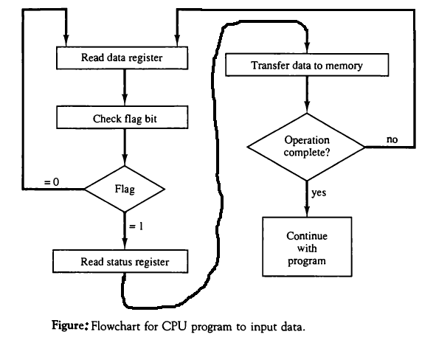
Cont.…

Slide 15
Interrupt-Initiated I/O
Program initiated I/O takes valuable CPU time
Open communication only when some data has to be passed → Interrupt
I/O interface, instead of the CPU, monitors the I/O device
When the interface determines that the I/O device is ready for data transfer, it generates an Interrupt request to the CPU
Upon detecting an interrupt, CPU stops momentarily the task it is doing, branches to the service routing to process the data transfer, and then returns to the task it was performing.

Slide 16
Contd..
The way that the processor chooses the branch address of the service routine depends on the type of interrupt used ie. Vector interrupt or non-vectored interrupt.
Non-vectored interrupt
The branch address is assigned to a fixed location in memory.
Vectored interrupt
The source that interrupts supplies the branch information to the computer.

Slide 17
Priority Interrupt
It requires to resolve the conflicts that occur if more than one device issue interrupts to the CPU
It establish a priority over the various sources to determine which condition is to be serviced first when two or more requests arrive simultaneously
If multiple source generates interrupt to CPU at a time then CPU provides services to highest priority first, and then next lower priority and so on.

Slide 18
Contd..
Establishing the priority of simultaneous interrupts can be done by:
Software priority interrupt
Polling procedure is used
Polls the interrupt sources in sequence
Priority of each interrupts depends on the order in which they are tested
Highest priority source is tested first, if its interrupt signal is on, then it is serviced otherwise the next lower priority source is tested and so on.
Disadvantage: if there are many interrupts, time required to poll them can exceed the time available to service the I/O device.

Slide 19
Contd..
Hardware priority interrupt
Require a priority interrupt manager which accepts all the interrupt requests to determine the highest priority request
Fast since identification of the highest priority request is identified by the hardware
Fast since each interrupt source has its own interrupt vector to access directly to its own service routine.
The hardware priority functions can be established by:
Serial connection of interrupt lines
Parallel connection of interrupt lines

Slide 20
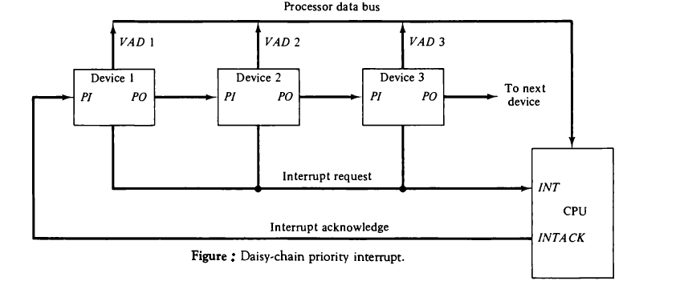
Serial connection of interrupt lines (Daisy-chain priority)

Slide 21
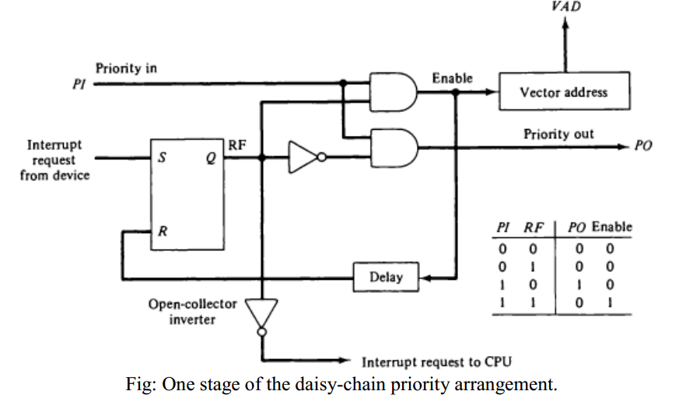
Contd..

Slide 22
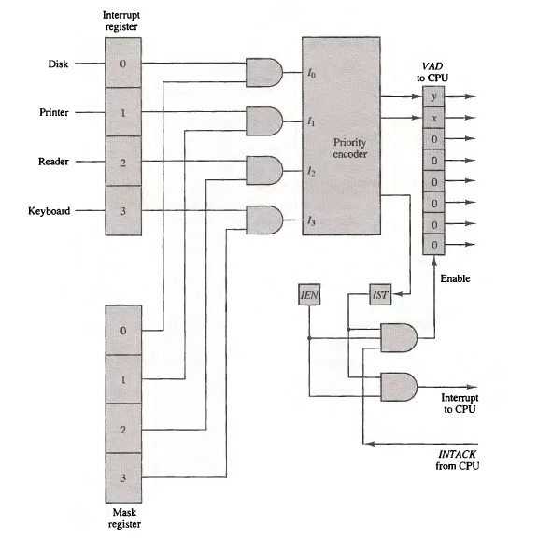
Parallel priority interrupt

Slide 23
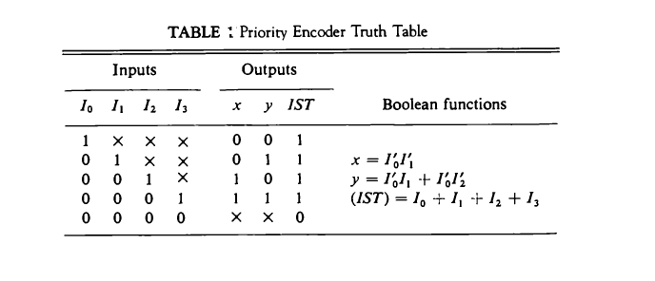
Contd..
Priority Encoder

Slide 24
Direct Memory Access (DMA)
Large blocks of data transferred at a high speed to or from high speed devices, magnetic drums, disks, tapes, etc.
DMA controller (Interface ) provides I/O transfer of data directly to and from the memory and the I/O device
CPU initializes the DMA controller by sending a memory address and the number of words to be transferred
Actual transfer of data is done directly between the device and memory through
DMA controller freeing CPU for other tasks

Slide 25
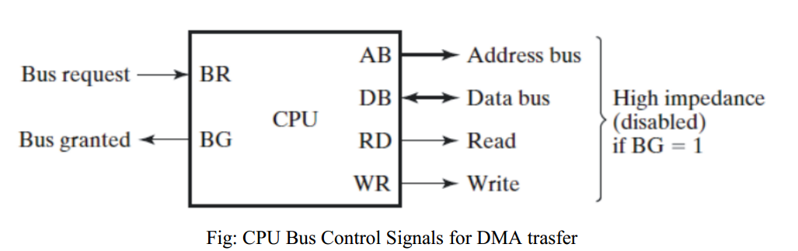
Contd..

Slide 26
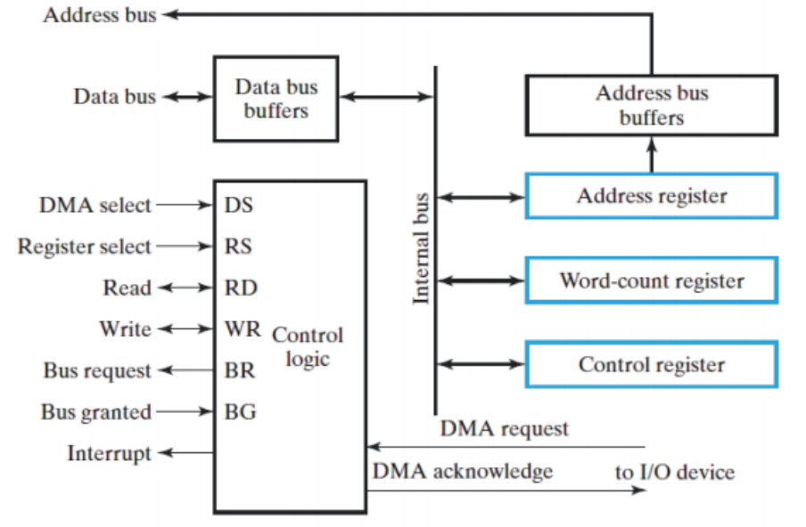
DMA controller

Slide 27
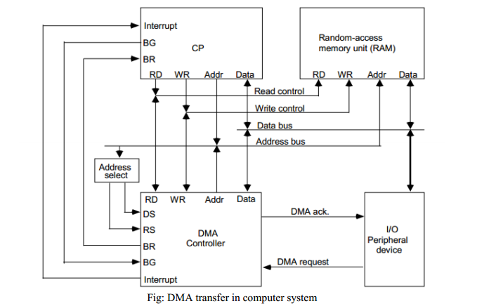
DMA Transfer

Slide 28
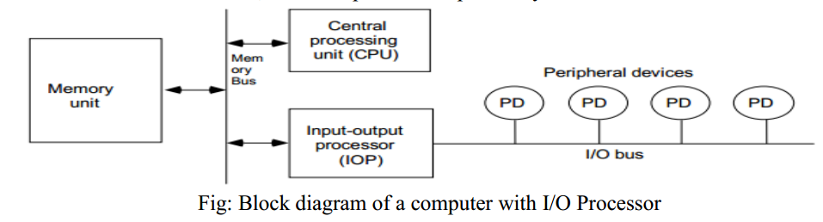
I/O Processor ( I/O Channel)

Slide 29
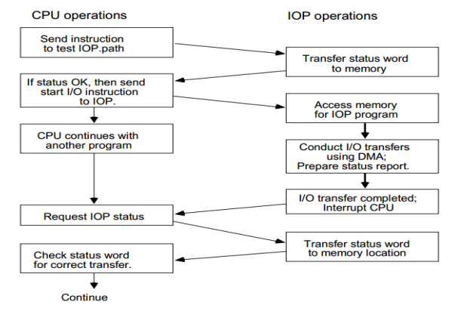
CPU – IOP communication

Slide 30
Assignments
Explain detail about I/O processor available in IBM 370.
Explain detail about 8089 IOP.

Slide 31
Data Communication Processor(DCP)
DCP is an I/O processor that distributes and collects data from many remote terminals connected through telephone and other communication lines.
It is a specialized I/O processor designed to communicate directly with data communication networks which may consists of wide variety of devices as printers ,displays, sensors ,etc. So DCP makes possible to operate efficiently in a time-sharing environment.
The main difference between IOP and DCP is the way processor communicates with I/O devices:
An I/O processor communicates with the peripherals through a common I/O bus i.e. all peripherals share common bus and use to transfer information to and from I/O processor.
DCP communicates with each terminal through a single pair of wires. Both data and control information are transferred in serial fashion.
DCP must also communicate with the CPU and memory in the same manner as any I/O processor.

Slide 32
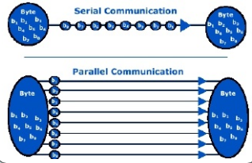
Contd..
Serial and parallel communication
Serial communication is the process of sending data one bit at a time, sequentially, over a communication channel or computer bus.
Parallel communication is a method of sending several data signals simultaneously over several parallel channels.

Slide 33
Contd..
Modes of Data Transfer
Data can be transmitted to and from peripherals in 3 different ways:
Simplex
Half Duplex
Full Duplex
Protocol
The orderly transfer of information in a data link is accomplished by means of a protocol. A data link control protocol is a set of rules that are followed by interconnecting computers and terminals to ensure the orderly transfer of information.

Slide 34
Contd..
Purpose of data link protocol:
To establish and terminate a connection between two stations
To identify the sender and receiver
To identify errors
To handle all control functions
Two major categories according to the message-framing technique used:
Character-oriented Protocol
Bit-oriented Protocol

